Slide 1
Project Vulpix
Week 3 Report

Slide 2

Game Board
Opponent’s hand
Opponent’s Bench
Opponent’s Active
Opponent’s Discard
Opponent’s prize
Opponent’s Deck
Stadium
Player’s Deck
Player’s Prizes
Player’s Bench
Player’s Discard
Player’s Hand
Player’s Active

Slide 3

Gameboard
Everything is coded as a list(what they call arrays in python)
Can use built in functions like pop(), append(), and len()

Slide 4
Turns
Draw a card
Play Trainers
Play Pokemon
Play Energy
Use Abilities
Retreat
Attack

Slide 5

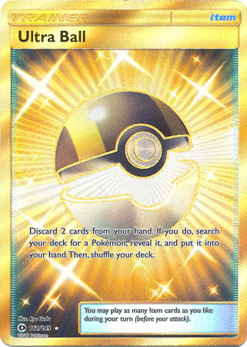
Play Trainers
Name
Type
Supporter
Once per turn
Items
Tools
Stadiums
Effect

Slide 6
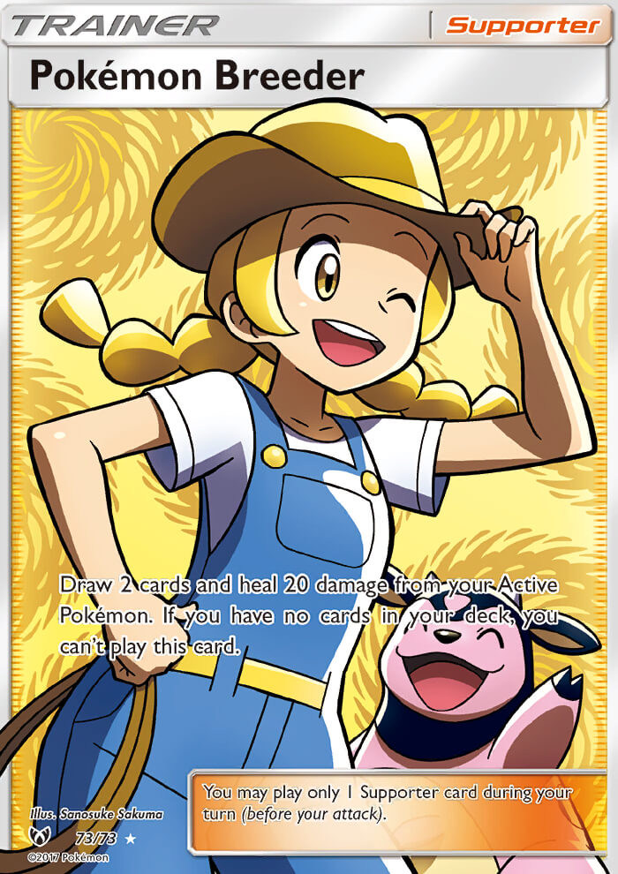
Supporter
Once per turn
Strongest Trainer Cards
Code
Function called playSupporter()
Searches hand and call function for effect
Bool to check if supporter has been played during turn (Gameboard)

Slide 7
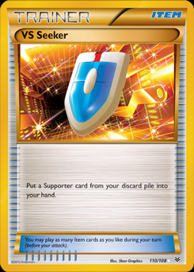
Items
Can play as many as desired
Various effects
Code
playItem()
Searches hand for item card and uses it’s effect

Slide 8
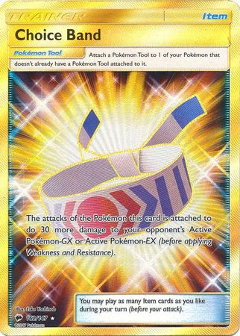
Tools
Special trainer that attaches to Pokemon
Stays on Pokemon until removed
Code
Not currently coded
Plan to have an “attached” list in Class Card
Function called attachTool()
Moves tool from hand to Pokemon.attach[ ]

Slide 9
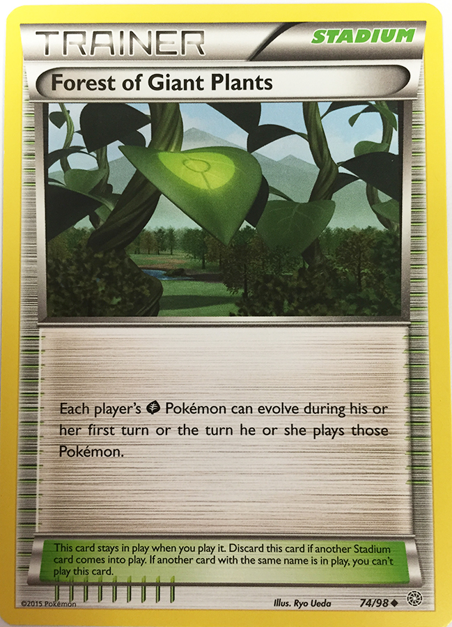
stadiums
Once per turn
Special restrictions – Can’t use if same named card is already in play
Special spot on gameboard for stadiums
Can be used by both players
Code
playStadium()
Checks to see if stadium in “stadium” list has same name
If not, removes old and plays current

Slide 10
Next Week
Finish turns
Figure out and implement attacking
Check for win conditions

